Slide 1
AppStore Release1.0 Requirement Design

Slide 2
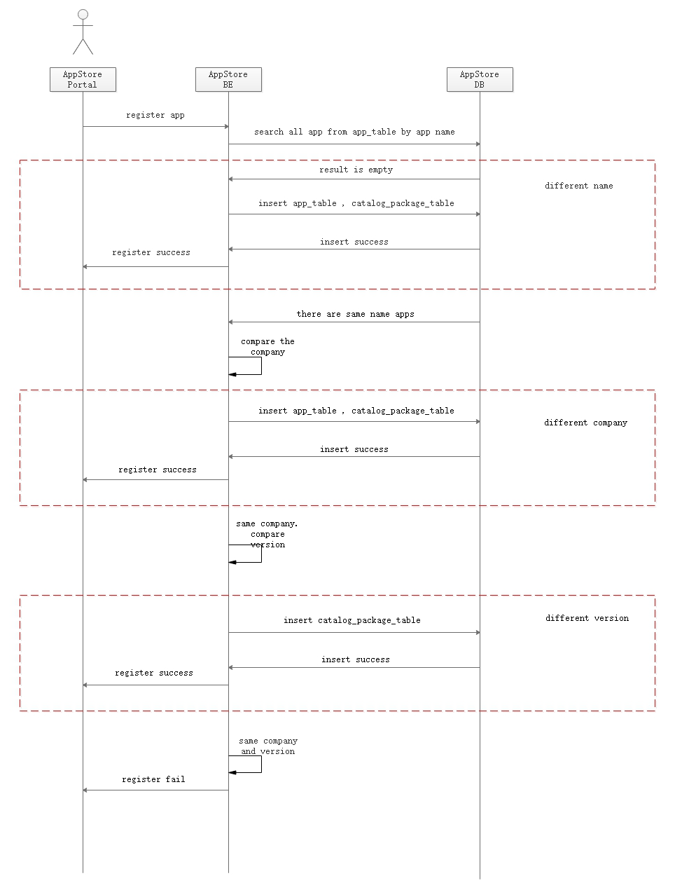
app package upload feature
Rules:
If the two apps have different name, they will show in two labels;
If the two apps have same name, different company, they will show in two labels;
If the two apps have same name and company, different version, they will show in one label;
If the two apps have same name , company and version , we will not allow the second app to upload.

Slide 3
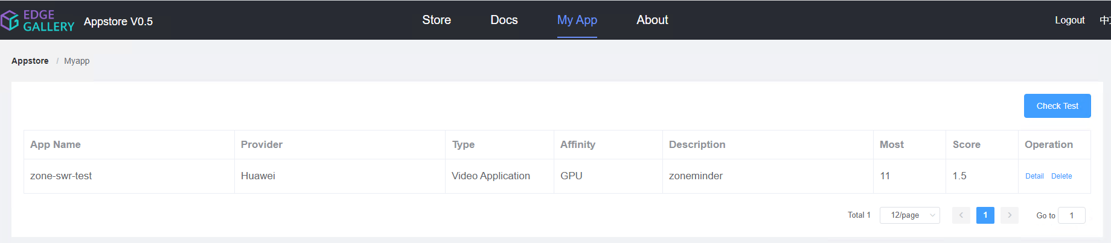
application management feature
Only the app creater can delete
User A upload an app with name zone-swr-test, company Huawei and version 1.0, and there are no same name app existed, so User A is zone-swr-test app creater.
User B upload an app with name zone-swr-test, company Huawei and version 2.0, but there is exist the app with version 1.0, so User B is only the zone-swr-test app partner.
Only A can delete app zone-swr-test, In the portal of User B, the delete should not be allowed.

Slide 4
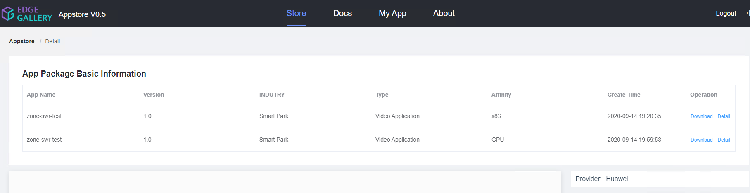
Delete
2.0
In the Operation, added the Delete operation
User A upload package with name zone-swr-test and version 1.0
User B upload package with name zone-swr-test and version 2.0
In the portal of User A, he can only Download and Delete the package with version 1.0. The Download and Delete of package with version 2.0 will not allowed to operate.
If the app does not have available package, the app will be delete by appstore

Slide 5
Story Analysis
模块 | Story Detail | Workload | Priority
appstore-be | Modify the rules for the app package upload and optimization the response message | 0.3K | High
appstore-fe appstore-be | Modify the download permission for the app and package to avoid the safe issue | 0.2K | High
appstore-fe appstore-be | Modify the delete permission for the app and package to avoid the safe issue | 0.2K | High

